Slide 1
NeTS-Vis: A Neural Net Based Visualization Frame work of Mobility Data Visualization
Chris Chen| Summer Student
February 2017

Slide 2
Background
Data
Mobility Data of User
Aim
Generate a framework to visualize some type of data
Getting useful features from this framework
User | Station | Start Time | End Time | IP Address
10202 | 10 | 2015-12-10 10:30:12 | 2015-12-10 10:31:12 | 10.10.20.10
10203 | 1001 | 2015-12-10 10:30:12 | 2015-12-10 10:32:12 | 10.12.40.10

Slide 3
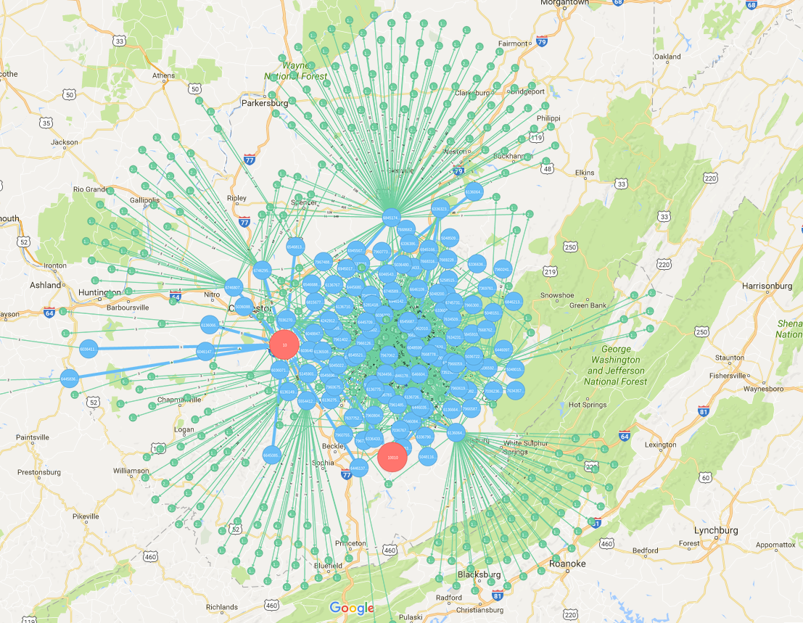
Previous Try
Animation
It is impossible to make a researcher to memory all details
Relation Model
When data comes larger, relationship would be massive
2D Based Map Analysis and 3D Time-Spatial Model
Either way has been proved that bad for comprehensive data
This is a bad example
Too much Information make it hard to interpret
Comprehensive relationships make things even harder

Slide 4
Our methods: NeTS-Vis
Front-End
HCI Visualization Tools
heat map, ER-model, 3D cube, charts
Back-End
Pure Time-oriented Data
Main Algorithm
Cluster – Self-Organizing Map
Prediction – Recurrent Neural Net

Slide 5
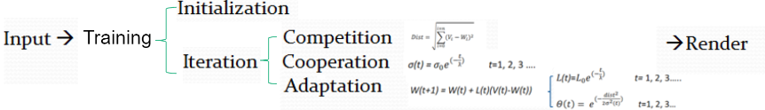
Cluster – Detect Special Users
Aim
Different Category of user can be found
Common Method:
K-Means: Need to define the number of clusters K
Gaussian Mixture Model(GMM): also need to find the number of Gaussian
Self-Organizing Map

Slide 6
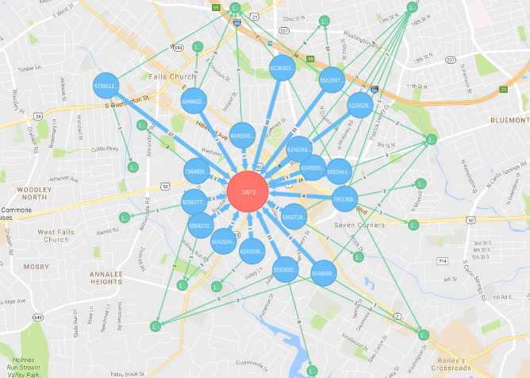
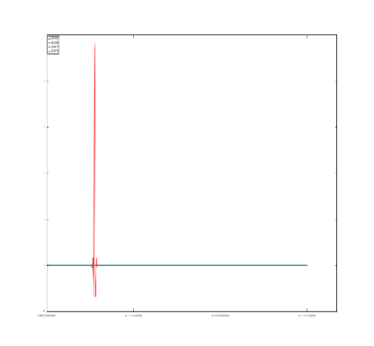
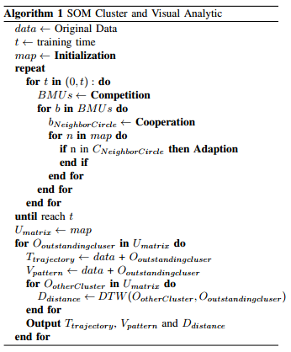
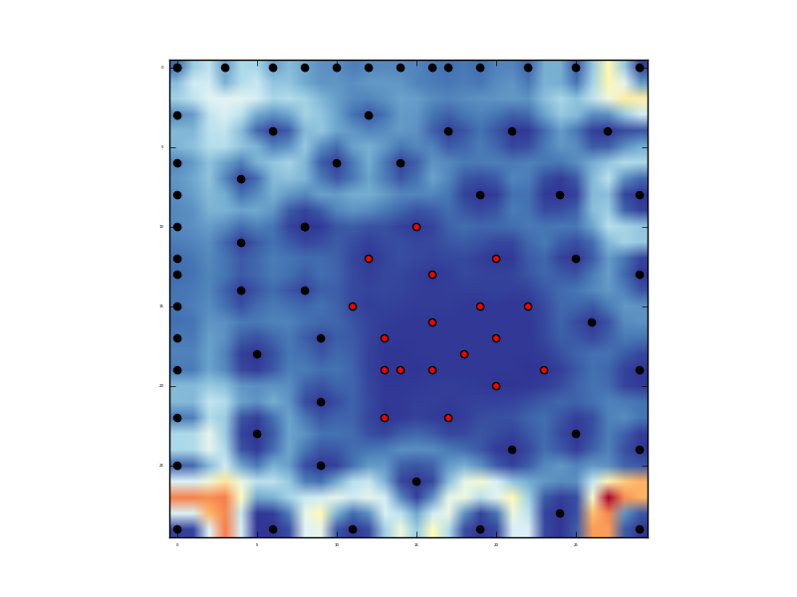
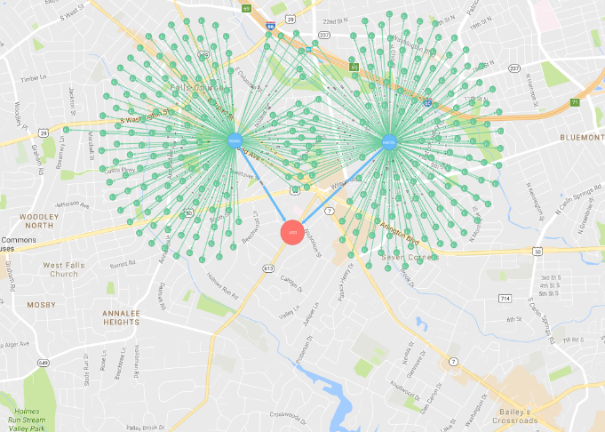
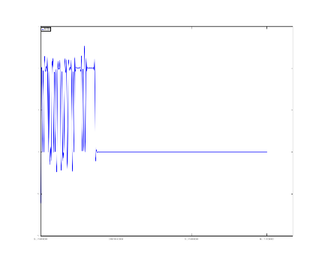
A adjusted way of SOM
Our Contribution:

Slide 7
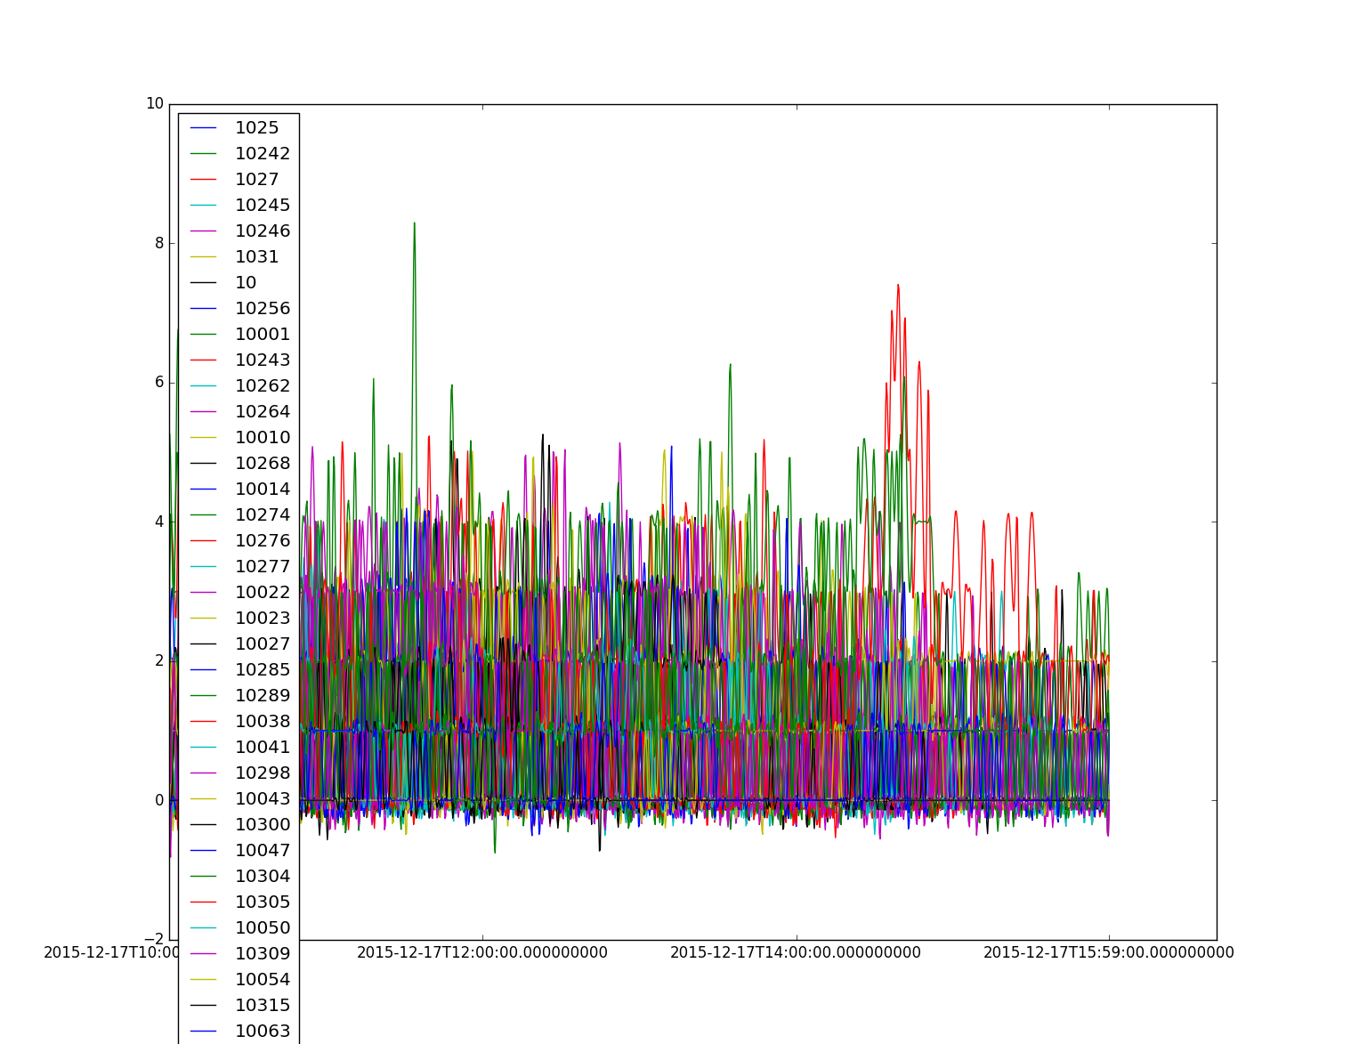
Prediction – Which Station would be busy
Aim
find out which station would be hotspot in next timestamp
Training
the previous time data
Processing
visit matrix
Method
RNN

Slide 8
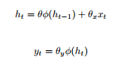
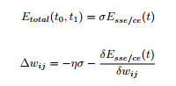
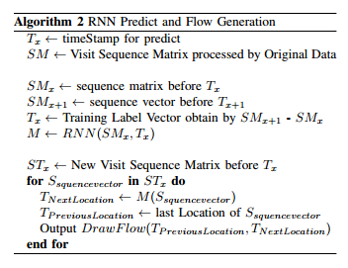
RNN – Long Short Term Memory
Forward Activation
Backward Propagation
Our Contribution

Slide 9
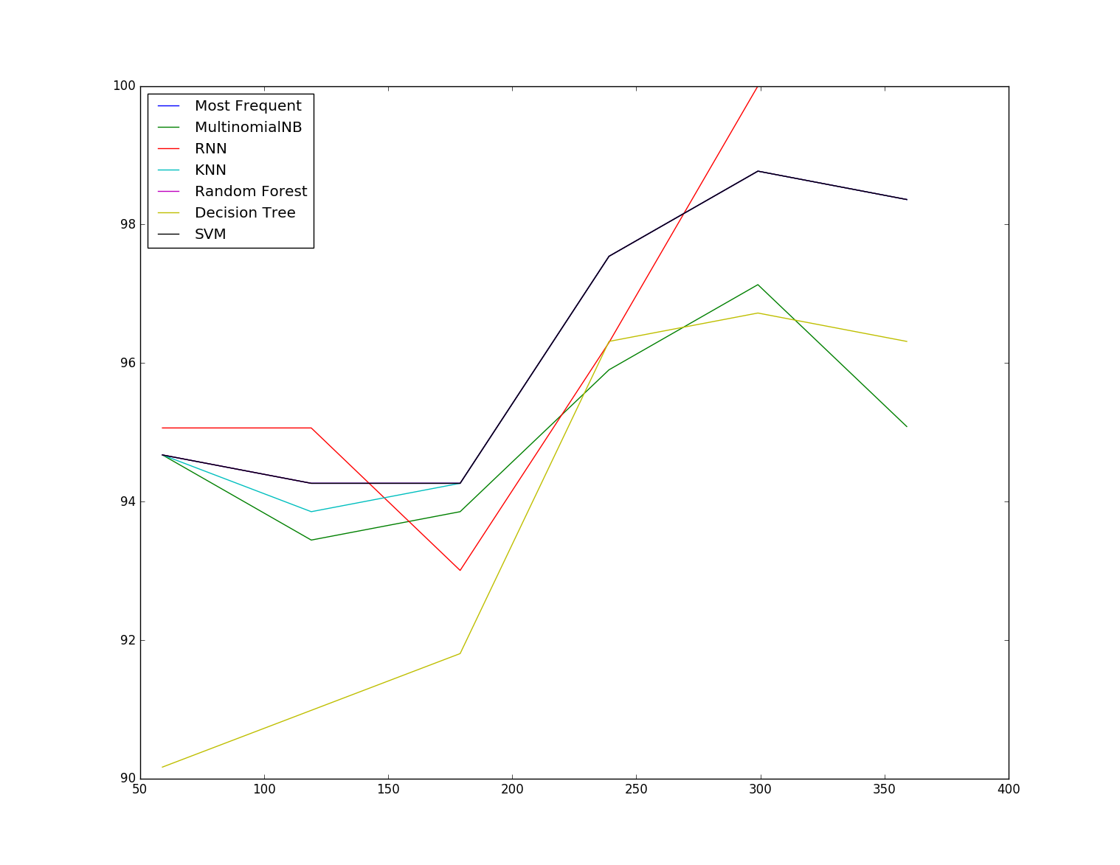
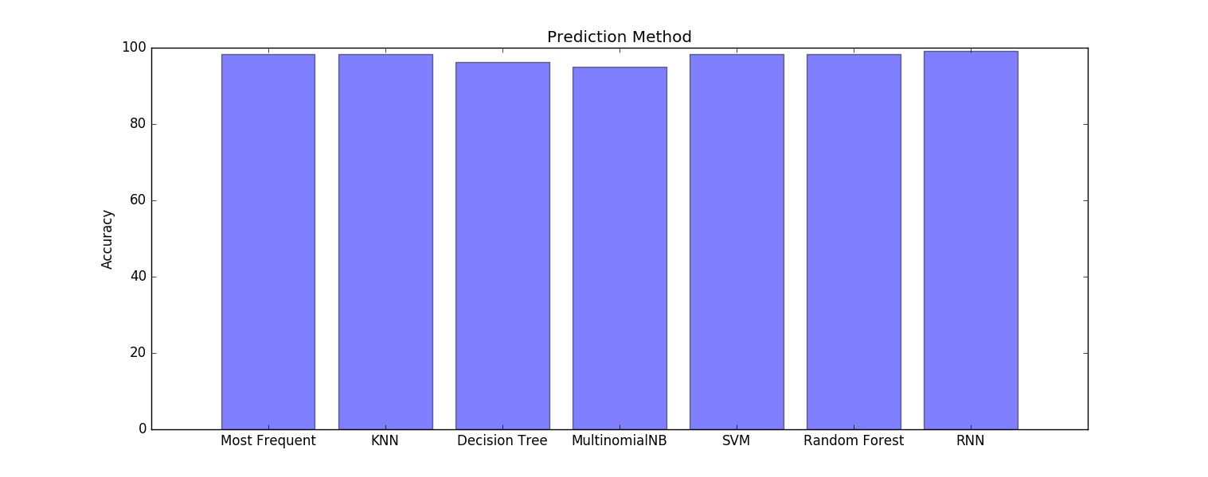
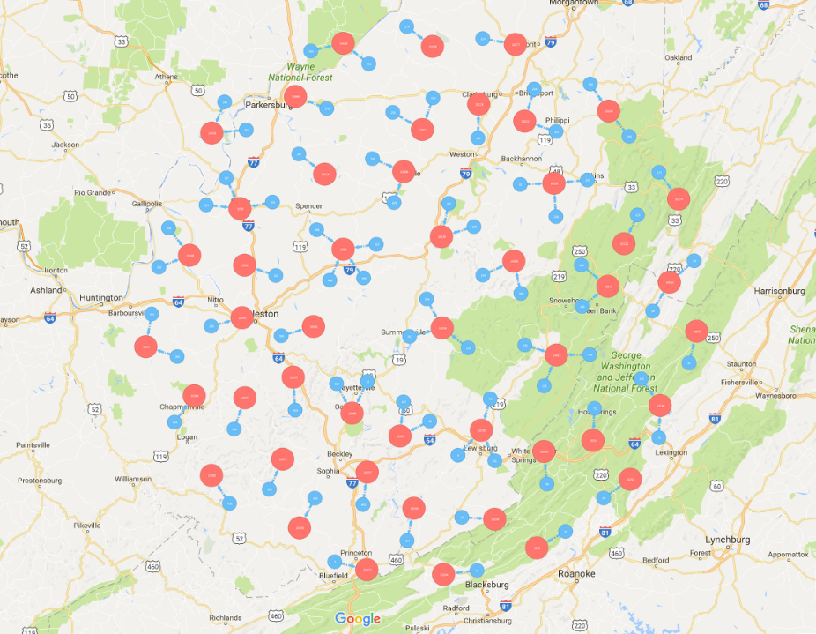
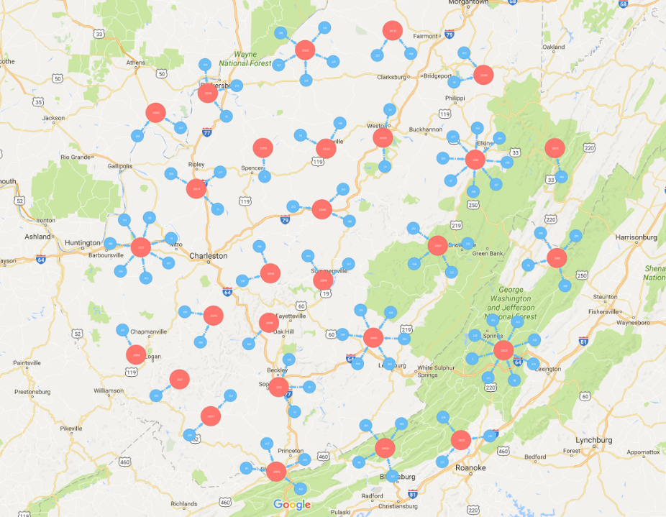
Result of LSTM
Real Visit Pattern Predict Visit Pattern

Slide 10
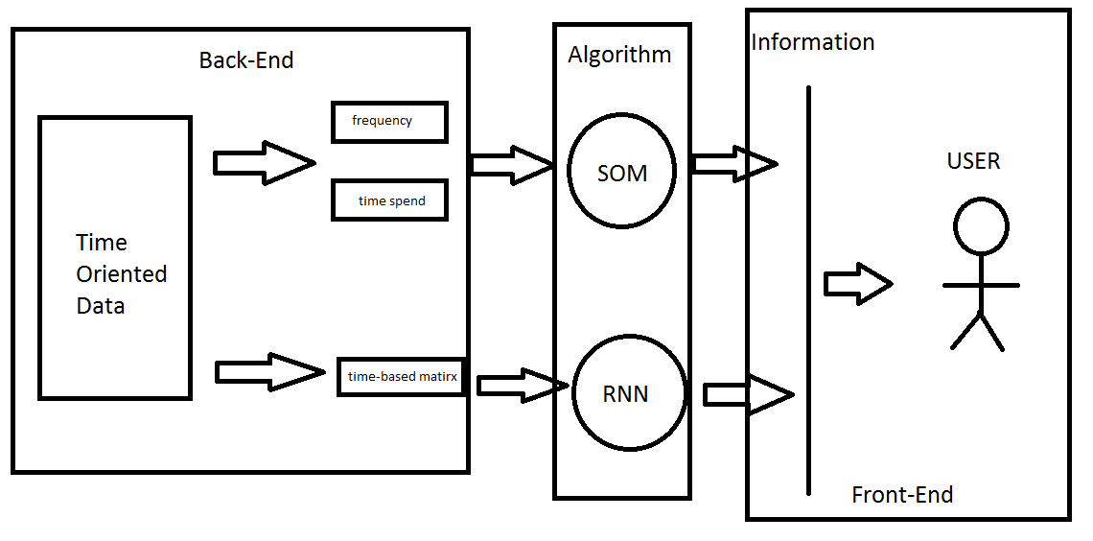
Summary

Slide 11
Reference
[1] Zhenghao Chen, Jianlong Zhou, Xiu Wang, Jeremy Swanson, Fang Chen, Dagan Feng “NesTS-Vis: Neural Net Based System for Time Spatial Data Visualization” The 30th International Joint Conference on Neural Networks (IJCNN 2017)
[2] Y. Zheng, Trajectory Data Mining: An Overview, ACM Trans Intell Syst Technol, vol. 6, no. 3, pp. 29:129:41, May 2015
[3] Shukla, Sanjiv Kumar, Sourabh Rungta, and Lokesh Kumar Sharma. ”Self-Organizing Map Based Clustering Approach for Trajectory Data.” International Journal of Computer Trends and Technology (IJCTT) 3.3 (2012): 321-324.
[4] G. Andrienko, N. Andrienko, I. Kopanakis, A. Ligtenberg, and S. Wrobel, Visual Analytics Methods for Movement Data, in Mobility, Data Mining and Privacy, F. Giannotti and D. Pedreschi, Eds. Springer Berlin Heidelberg, 2008, pp. 375410.
[5] Liu, Qiang, et al. "Predicting the Next Location: A Recurrent Model with Spatial and Temporal Contexts." Thirtieth AAAI Conference on Artificial Intelligence. 2016.
[6] LeCun, Yann, Yoshua Bengio, and Geoffrey Hinton. "Deep learning." Nature521.7553 (2015): 436-444.

Slide 12
Thank you
Chris Chen Summer Student
e chris.chen@data61.csiro.au

